Slide 1
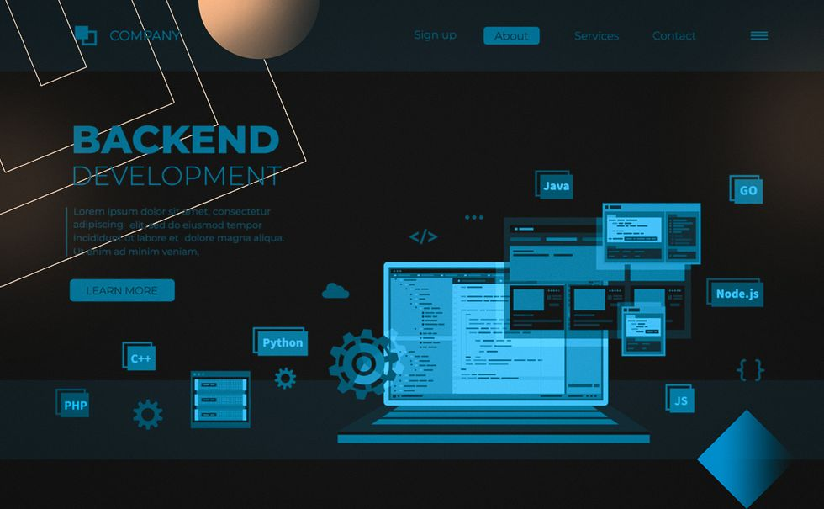
BACKEND DEVELPOMENT

Slide 2

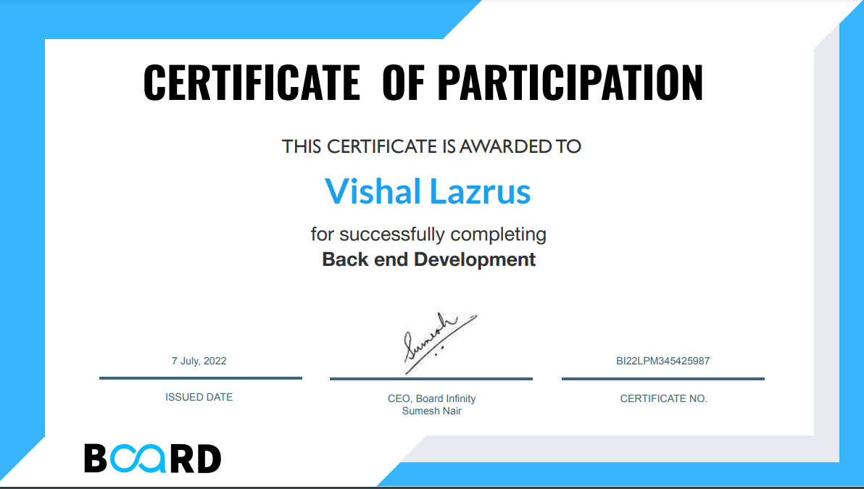
w
Name-Vishal Lazrus
Reg.no-12004235
Platform-Bord Infinity

Slide 3

CONTENT
1.Introduction
2.JavaScript
3.Node.js
4.MongoDB
5.API
6.Postman
7.Conclusion

Slide 4
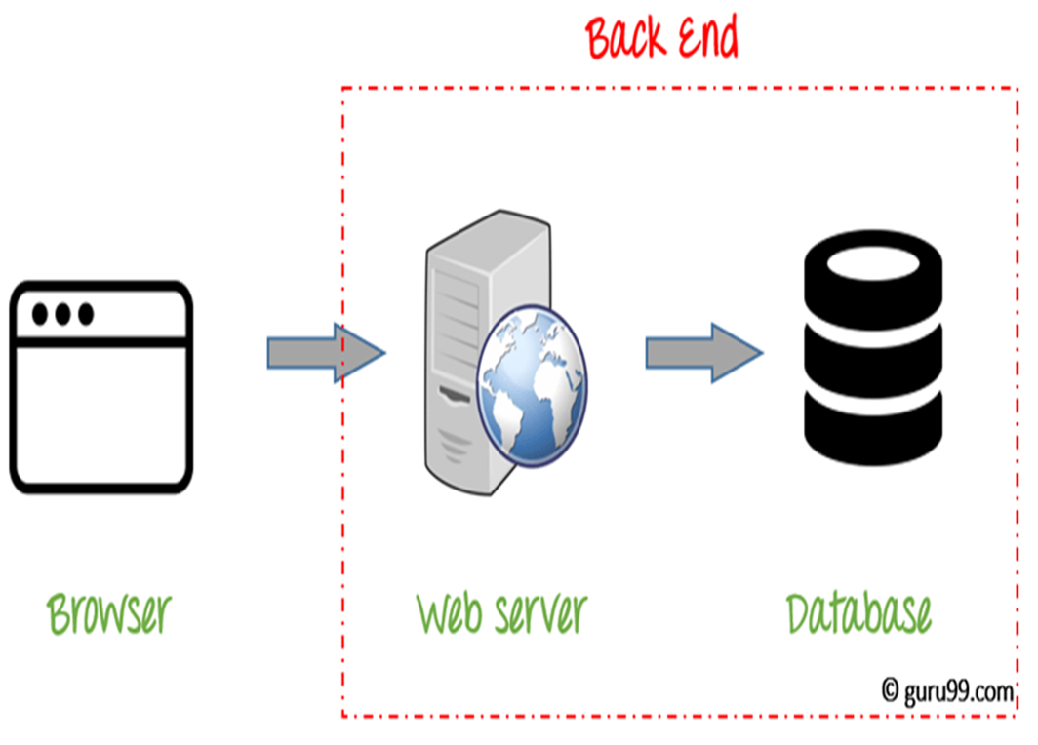
INTRODUCTION
Back-end Development refers to the server-side development. It focuses on databases, scripting, website architecture.

Slide 5
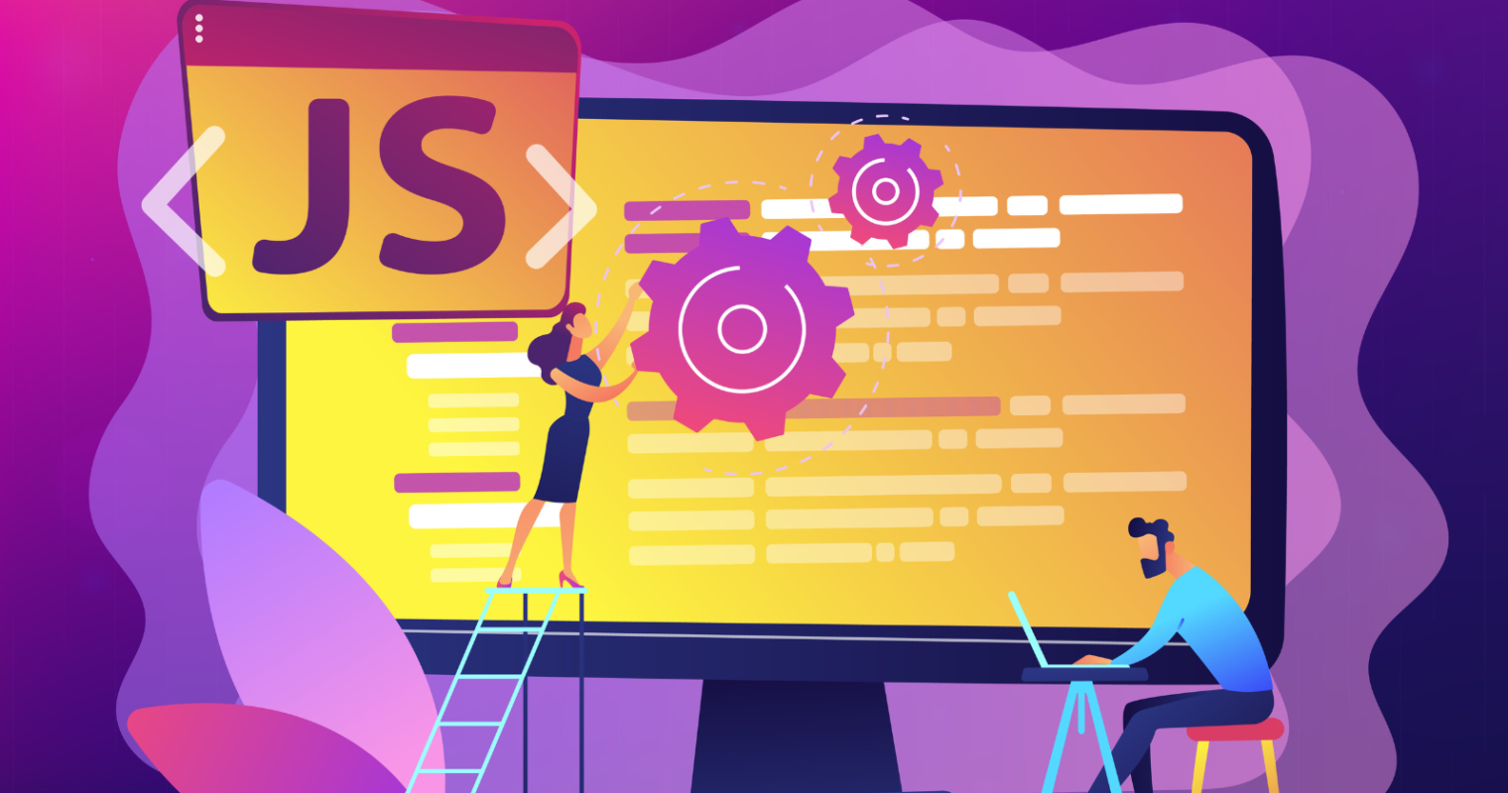
javascript
JavaScript is a dynamic computer programming language. It is lightweight and most commonly used as a part of web pages, whose implementations allow client-side script to interact with the user and make dynamic pages

Slide 6
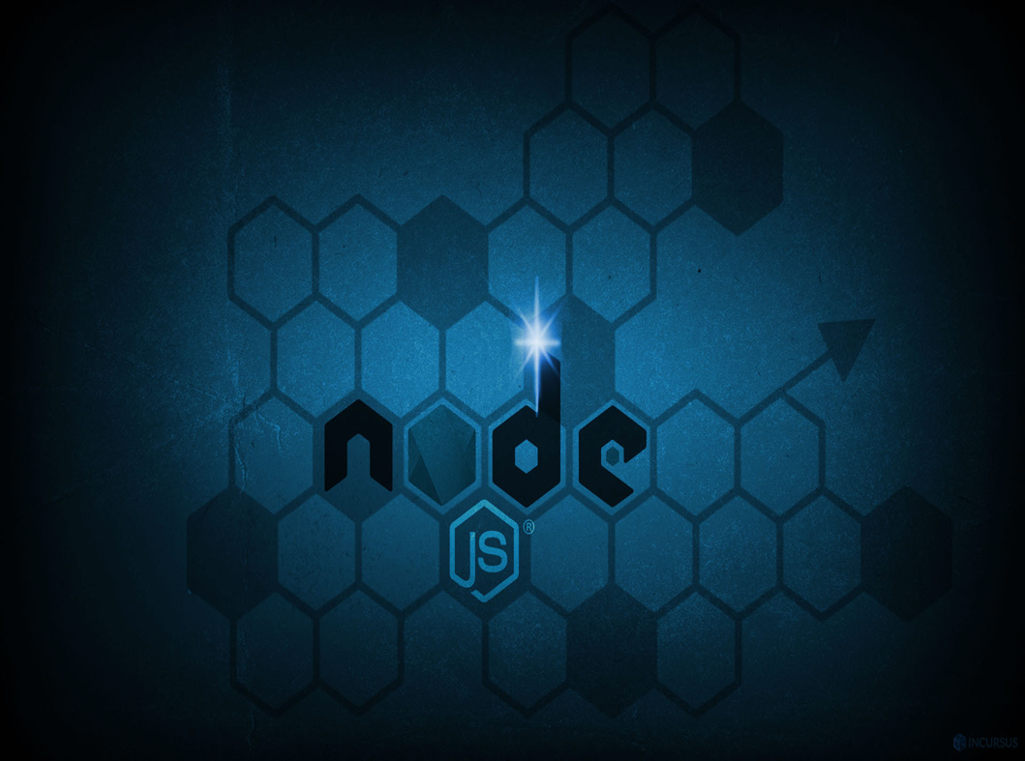
NODE.JS
Node.js is a very powerful JavaScript-based platform built on Google Chrome's JavaScript V8 Engine.
Node.js is an open source, cross-platform runtime environment for developing server-side and networking applications.

Slide 7

MONGODB
MongoDB is an open-source document-oriented database that is designed to store a large scale of data and also allows you to work with that data very efficiently.

Slide 8
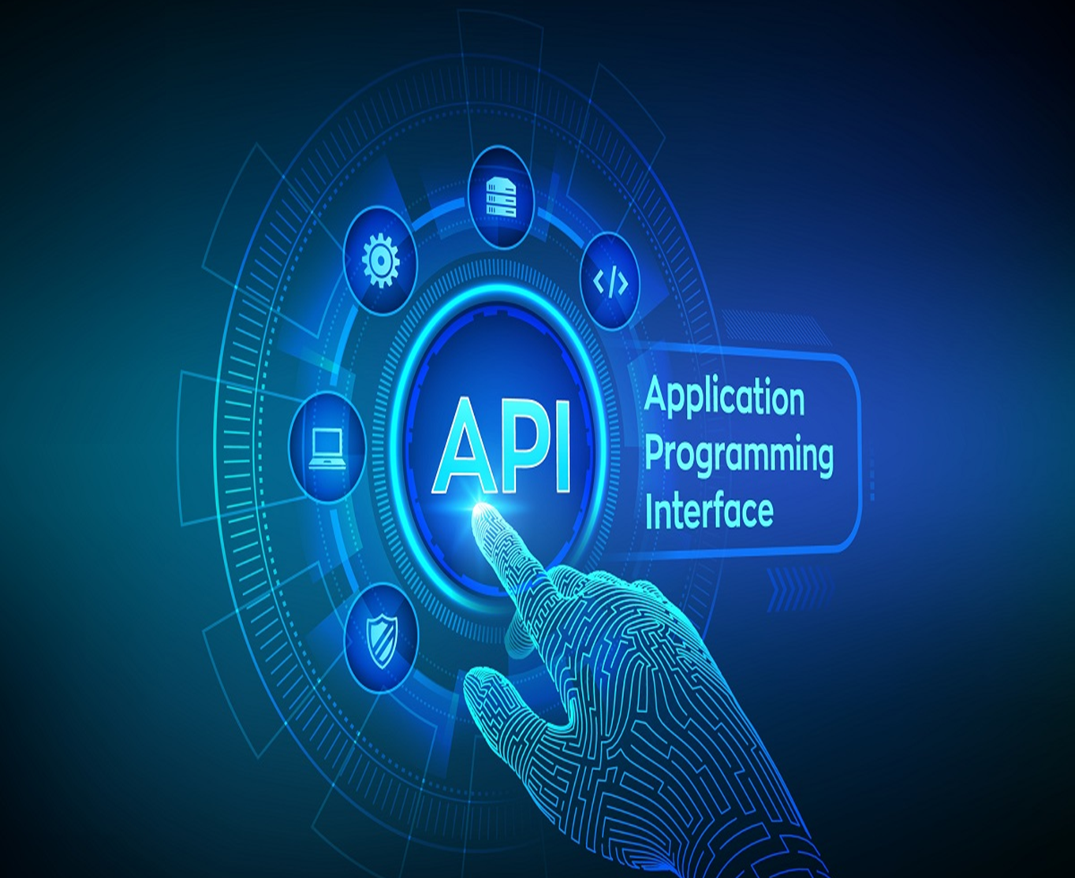
API
API stands for Application Programming Interface. In basic terms, APIs are a set of functions and procedures that allow for the creation of applications.

Slide 9
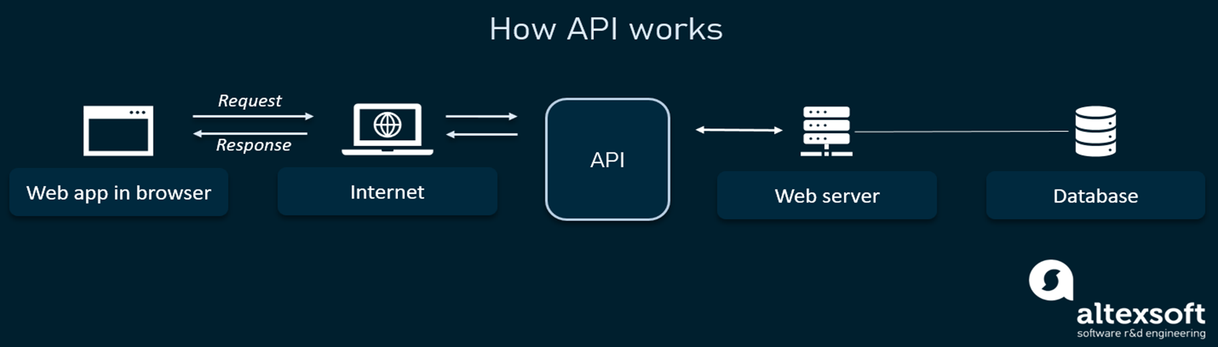
API is not the database or even the server; it’s the code that governs the server’s access point(s). An API is like a common language, a communications mechanism between developers.

Slide 10
POSTMAN
Postman is an API(application programming interface) development tool which helps to build, test and modify APIs

Slide 11


Slide 12


